Slide 1
ISO Developer’s Toolkit - Using mdTranslator 2015 CDI Workshop
May 11, 2015
Stan Smith, USGS

Slide 2


Web Application
POST
Public hosted web service
Ruby code
Ruby Gem
mdTranslator-rails

Slide 3
Web Application
mdCodes
Ruby Gem
GET/POST
Public hosted web service
Ruby code
Ruby Gem
mdTranslator-rails

Slide 4
Interacting with the hosted mdTranslator
Using REST (Representational State Transfer)
Architectural style for scalable web services
All functionality is available via unique URLs (aka resources or end-points)
URLs only support GET and POST operations, no PUTs (updates) or DELETEs accepted
Root domain is http://mdtranslator.adiwg.org/

Slide 5
Welcome page - http://mdtranslator.adiwg.org/
Overview
Background
Including description of the six ISO Metadata Developer’s Toolkit components
Links
mdTranslator resources
API .../api/v1
Readers .../api/readers
Writers .../api/writers
Related external resources
mdTranslator Home page http://www.adiwg.org/mdTranslator/
mdTools http://www.adiwg.org/mdTools/
GitHub repository https://github.com/adiwg
RubyGems libraries https://rubygems.org/

Slide 6
API V1 documentation .../api/v1/api
Versioned to support previous versions
Documentation and Lists
GET
Informational web pages
Interacting with codeLists
API version 1 information, options, and testing
mdTranslator method
GET
Limited application due to URI size limits (2K)
POST
mdTranslator parameters
mdTranslator parameter options

Slide 7
/api/v1/options # returns JSON coded supported options for mdTranslator
/api/v1/demo # html form to test mdTranslator options
Uses POST from html form
Show in Fiddler?
Demonstrate options from demo page

Slide 8
Separate Ruby module and gem from mdTranslator
To be used by metadata content editors (mdEditor) to load codeList options
Each codelist is a separate YAML file
“Yet Another Markup Language” or “YAML Ain’t Markup Language”
Suited for text editing structured data
Supported in Ruby, Python, Perl, grep
Only supporting static codelists at this time
May play a role to provide consistent API for externally maintained hierarchical code lists such as
GCMD Global Change Master Directory of Earth Science Keywords (NASA)
Several candidates from NOAA
ITIS
GNIS

Slide 9
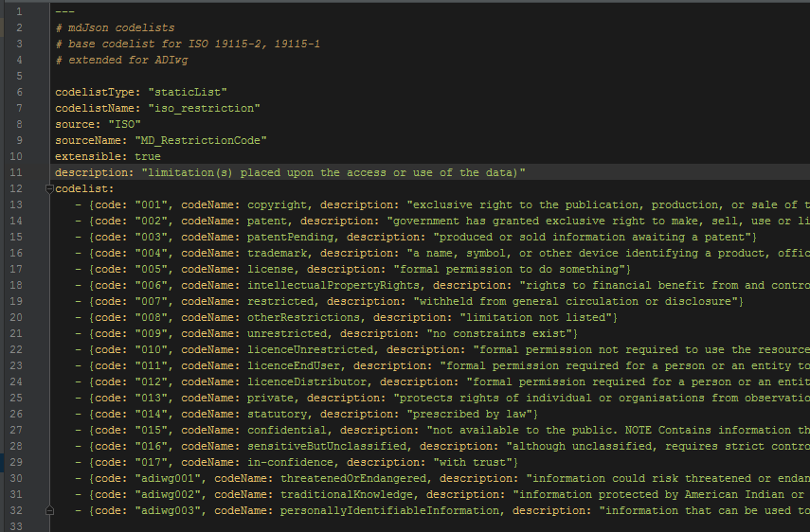
Static codelist example

Slide 10
api/codelists – use chrome w/ JSON viewer
/codelists # returns JSON codelist name w/codes
/codelists?format=json # default (same as above)
/codelists?format=xml # CT_CodelistCatalogue
/codelists?definitions=true # codes and definitions
/codelists?callback=myCall # JSONp wrapper

Slide 11
Questions?
Discussion?

